Slide 1

School of Computer Science and Engineering (SCOPE)
CSI3007 - Advanced Python Programming
Dr. Biji C. L.
Associate Professor, Department of Analytics

Slide 2
Classes in Python

Slide 3
Object-Oriented Programming
It is built on the idea of objects and classes.
In real life, the concept of object orientation can be roughly conceived as “keeping related things together”.

Slide 4
Object oriented programming:
Involves keeping related things (variables and functions) together as a single unit, packaged well (encapsulated) with copies possible for reuse, with changes if needed. Such a single unit is called a class.

Slide 5
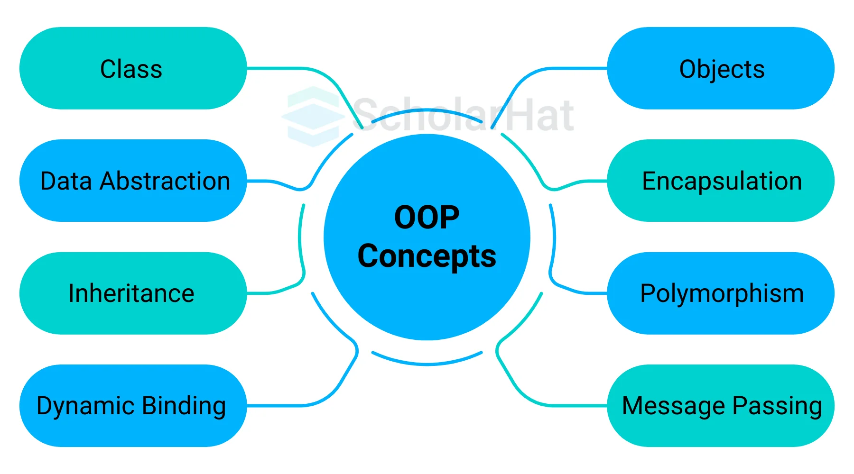
Basic Concepts of OOPs

Slide 6
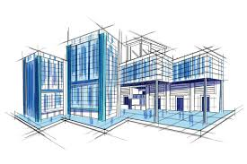

Defining a Class
A class is a special data type which defines how to build a certain kind of object.
  The ‘class’ also stores some data items that are shared by all the instances of the class.
  ‘Instances’ are objects that are created which follow the definition given inside of the class.

Slide 7
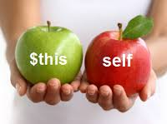
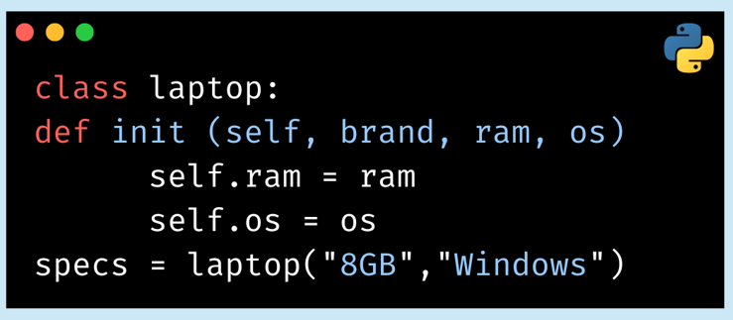
Methods in Classes
You can define a method in a class by including function definitions within the scope of the class.
  a special first argument self in all of the method definitions – it is a reference to the current instance of the class.
  a special method called __init__ in most classes

Slide 8
Classes and Objects
A class can be understood as a template or a blueprint, which contains some values, known as data members, and some set of rules, known as behaviors or methods.
The data and methods that are defined in the class are automatically taken when an object is created.
The class is a template or blueprint for objects. One can make as many objects as they want to be based on a class.

Slide 9
Classes and Objects
A class is a structure which has provision to hold data and functions.
Typically it does not hold data, it is like a hollow structure which can hold data (template/shell/form etc are words that can describe the idea). When we fill the data in a copy of the structure, we have an object

Slide 10
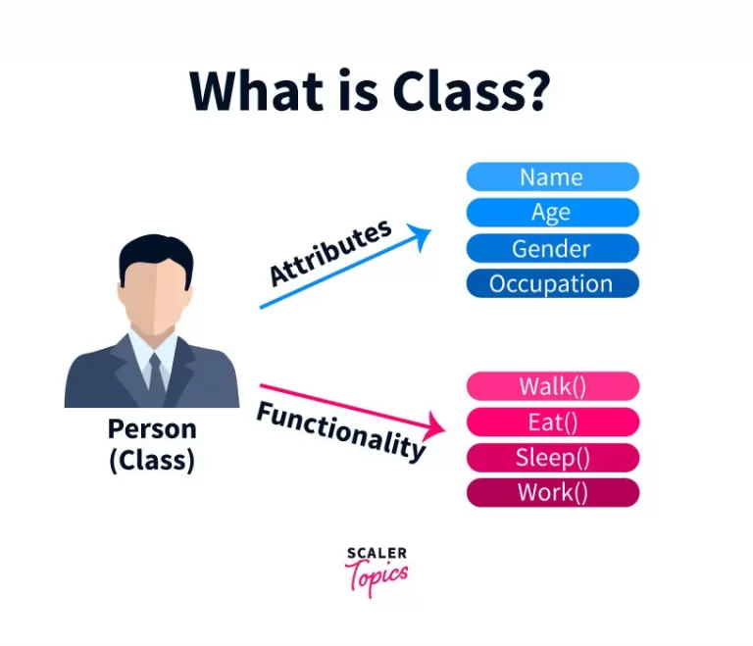
Class

Slide 11
Class in Python
Class | Objects belonging to the class
int | 2, 5, -7, 345
float | 2.0, -34.5, 0.0089
char | ‘a’, ‘A’, ‘+’
str | ‘Hello’, ‘Bye’

Slide 12
Class in Python

Slide 13
Class in Python
Every class has a special function named __init__ which is used to define the attributes of the class.
All functions including __init__ has to have the first parameter as self, which refers to the current object itself. All attribute names are of the form self.x.
A class can have any number of attributes and methods.

Slide 14
Toy Example
Guess?
Class Definition
Name of Class
Attributes
Name of constructor
Arguments of constructor
No of Methods
Names of Methods
Object names
Instantiation statement
Method called on object:
Result of method call:
Constructor Function Definition
Ordinary Method/Function Definition
Object Instantiation
Calling methods/function/procedures on objects

Slide 15
Define class for Person

Slide 16
Activity-1
Define a class Number Pair which takes two numbers as arguments and has functions to produce sum, difference and product. After defining the class, create an instance of the class NumberPair and call the functions to produce sum, difference and product.
n1=NumberPair(5,6)
n1.sum()
class Number Pair:
def __init__(self, a,b):
self.x=….; self.y=…..
def sum(self):
print(self.x + self.y)
def difference(self):
………………………………………….
def
……………………………………………

Slide 17
Activity-2
c. Define a class Circle (arguments: radius r)with methods to calculate area and circumference | After defining the class, create an instance of the class and call the different functions.
d. Define a Triangle class (arguments: sides a, b, c) with methods to calculate area type (consider isosceles, equilateral and scalene) | After defining the class, create an instance of the class and call the different functions.
e. Define a Rectangle class (arguments: sides l, b) with methods to calculate area and perimeter | After defining the class, create an instance of the class and call the different functions.

